Slide 1

James Lonergan
2/21/2024

Slide 2

Outline
Executive Summary
Introduction
Methodology
Results
Conclusion
Appendix

Slide 3
Executive Summary
Summary of methodologies
Booster test data was gathered from SpaceX via both web scraping and the SpaceX API
The data was parsed formatted and cleaned
Intial statistical and graphical analysis, was performed using SQL, Pandas, Numpy, Seaborn, Plotly, and Folium
Some results are displayed in a Dash App
Predictive analysis was performed using a variety of models and grid search optimization
Summary of all results​:
The Falcon 9 rocket performances can be seen to be the product of a few factors: Launch Site, Payload Mass, Orbit, and Flight Date, with more recent flights having higher success rates. Large payloads, and certain Orbits tended to have lower success rates. Similarly, at Launch Sites with lower success rates, more of the early flights occured. Launch Success predictions were made with an accuracy of 83%, and little variability across the tested algorithms. A larger test set size might improve the predictive capacity of the models.

Slide 4
Introduction
Project background and context
This capstone project leverages a wide range of data science skills to analyze SpaceX rocket flight data from the perspective of a SpaceX competitor.
Successful recovery of the rocket booster reduces the launch cost by 62%. A competitor who can predict the success of a planned launch is in an advantageous position.
By investigating the data, factors that contribute to flight success can be determined, and a predictive model developed that informs project budgets and future flight decisions

Slide 5

Section 1

Slide 6
Methodology
Executive Summary
Data collection methodology:
Data was collected from the SpaceX website using two methods:
SpaceX provides the data in an API in JSON format
The data can be scraped directly from the webpage
Perform data wrangling
The data was cleaned and processed using SQL and Numpy, null values were removed, and a Class column was created that represents launch success as 1 and failure as 0.
Perform exploratory data analysis (EDA) using visualization and SQL
Trends in the data can be seen using a variety of statistical and graphical methods.
Relationships can be seen using scatterplots, bar charts and time series plots

Slide 7
Methodology
Executive Summary Cont.
Perform interactive visual analytics using Folium and Plotly Dash
Spatial data can be evaluated using Folium maps, and interactive dashboards make visual analysis of variables, trends and relationships easy and fast.
Perform predictive analysis using classification models
Models were developed using a comparitive approach, and a grid search optimization algorithm.
4 model types were used: linear, SVN, Decision Trees, and KNN.

Slide 8
Data Collection
The data was gathered from the SpaceX website API, and also via web scraping. It was necessary to download some reference data, and map that data to additional tables, using a few additional API requests, and keys found in the reference dataset called launches. The following slides present detailed process diagrams for the different data collection methods, as well as the notebooks they were performed in.

Slide 9
Data Collection – SpaceX API
GitHub URL:
https://github.com/jlonergan35/python_capstone/blob/e8108a58c6b7e853a01db4fd24354fe4d43b5e10/jupyter-labs-spacex-data-collection-api.ipynb
Launches
Rocket
Booster Version
Payload
Mass
Orbit
Launchpad
Latitude
Launch site
Longitude
Cores
Outcome
Flights
Landing Pad
Gridfins
Flight Number
Date
Serial
Reused Count
Reused
Block
API Requests Flow Chart

Slide 10
Data Collection - Scraping
WebScraping notebook:
https://github.com/jlonergan35/python_capstone/blob/e8108a58c6b7e853a01db4fd24354fe4d43b5e10/jupyter-labs-webscraping%20(1).ipynb
Scrape the Page
Locate Tables
Extract Column Names
Build Dictionary
Include column headers
Create additional headers
Iterate through the data
Store values
Save table for the next step
Validate flight number

Slide 11
Data Wrangling
Once Gathered, the data was processed, cleaned and formatted for analysis
The data was filtered to include only a certain date range, and only Falcon 9 Rockets
Null values were replaced with mean values for the column Payload Mass
The data was analyzed to determine which landing outcomes constitute a success and which a failure
A new column was created to indicate success or failure with 1 or 0
URL: https://github.com/jlonergan35/python_capstone/blob/e8108a58c6b7e853a01db4fd24354fe4d43b5e10/labs-jupyter-spacex-Data%20wrangling.ipynb

Slide 12
EDA with Data Visualization
Data Visualization Charts:
A scatter plot of flight number vs payload mass (grouped by success class)
A scatter plot of flight number vs launch site (grouped by success class)
A scatter plot of payload mass vs launch site (grouped by success class)
A bar chart of success rate by orbit
A scatter plot of flight number vs orbit (grouped by success class)
A scatter plot of payload mass vs orbit
A time series line plot of average annual success rate
URL: https://github.com/jlonergan35/python_capstone/blob/e8108a58c6b7e853a01db4fd24354fe4d43b5e10/jupyter-labs-eda-dataviz.ipynb.jupyterlite%20(1).ipynb

Slide 13
EDA with SQL
SQL queries
sql create table SPACEXTABLE as select * from SPACEXTBL where Date is not null
sql SELECT DISTINCT "Launch_Site" FROM SPACEXTABLE
Sql SELECT "Launch_Site" FROM SPACEXTABLE WHERE "Launch_Site" LIKE "%CCA%" LIMIT 5
Sql SELECT sum(Payload_Mass_KG_) FROM SPACEXTABLE
Sql SELECT avg(Payload_Mass_KG_) FROM SPACEXTABLE WHERE "Booster_Version" LIKE "F9 V1.1"
Sql SELECT min(Date) FROM SPACEXTABLE WHERE "Landing_Outcome" = "Success (ground pad)
Sql SELECT "Landing_Outcome" FROM SPACEXTABLE WHERE "Booster_Version" = "Success (drone ship)" AND "Payload_Mass_KG_" > 4000 AND "Payload_Mass_KG_" < 6000
Sql SELECT COUNT(Mission_Outcome), "Mission_Outcome" FROM SPACEXTABLE GROUP BY "Mission_Outcome"
Sql SELECT "Booster_Version" FROM SPACEXTABLE WHERE "Payload_Mass_KG_" = SELECT MAX(Payload_Mass_KG_) FROM SPACEXTABLE
%sql select substr(Date, 6,2), "Landing_Outcome","Booster_Version","Launch_Site" from SPACEXTABLE where "Landing_Outcome" = "Failure (drone ship)" AND substr(Date,0,5)='2015' "
%sql SELECT count(Landing_Outcome),"Landing_Outcome" FROM SPACEXTABLE WHERE "Date" BETWEEN '2010-06-04' and '2017-03-20' group by "Landing_Outcome" ORDER BY count(Landing_Outcome) DESC
URL: https://github.com/jlonergan35/python_capstone/blob/e8108a58c6b7e853a01db4fd24354fe4d43b5e10/SQL_lab_coursera.pdf (PDF, the lab would not save any of my work, so I took screens)

Slide 14
Build an Interactive Map with Folium
In order to make inferences on the geospatial data, map markers were added to the folium map.
Circle markers were added to indicate each of the launch sites, with hover over text.
Marker clusters were added to indicate launch success or failure at each launch site and color coded
A mouse position marker was added to show geospatial coordinates at mouse locations. This marker was used to measure the distance between one of the launch sites and the coast.
A line was added to mark the distance measured between on of the launch sites and the nearest coastline.
URL: https://github.com/jlonergan35/python_capstone/blob/e8108a58c6b7e853a01db4fd24354fe4d43b5e10/module_3_lab_jupyter_launch_site_location.jupyterlite.ipynb

Slide 15
Build a Dashboard with Plotly Dash
A Dash web application was built to render interactive figures for data analysis.
The figures were developed using the Plotly package, which is a high-level interactive plotting library with many interactive features built in.
Two figures were created:
A pie chart that incorporated a user definable dropdown menu, with options to select All Launch Sites or an individual launch site. The pie chart rendered the percentage of successful launches from each site if all sites are selected, or if 1 site is selected the pie chart shows the percentage of succesful and not succesful launches.
A scatter plot was created with a slider range based on payload mass, comparing payload mass to success rate with the color variable set to booster type
These plots highlight some of the likely dependencies found in the data, and allow the data scientist to interact with the data to get a better sense of the impact of variables on each other, and to change the resolution of the data.
URL of app code and screenshots:
https://github.com/jlonergan35/python_capstone/blob/e8108a58c6b7e853a01db4fd24354fe4d43b5e10/dash_interactive.py
https://github.com/jlonergan35/python_capstone/blob/a06c81f1d6965ab7aed5d7940882728600e1f28b/dash%20app%20screens.pdf

Slide 16
Predictive Analysis (Classification)
Logistic Regression
Build search grid
Search on regularization
Optimize training model
Evaluate fitness on test data
83% accuracy on 18 datapoints
Plot confusion matrix
Misclassification is a problem
Support Vector Machine
Build search grid
Across kernal, regularization and the gamma parameter
83% accuracy across 18 data points
Decision Tree
Across Criterion, Max depth, Max features, Min samples, Min samples split and splitter
Optimize training model
Optimize training model
Evaluate fitness on test data
Plot confusion matrix
Misclassification is a problem
Misclassification is a problem
K-Nearest Neighbors
Build search grid
Build search grid
Across neighbors, algorithm and P
Evaluate fitness on test data
77% accuracy across 18 data points
Plot confusion matrix
Misclassification is a problem
Evaluate fitness on test data
83% accuracy across 18 data points
Plot confusion matrix
Split data into Train and Test sets

Slide 17
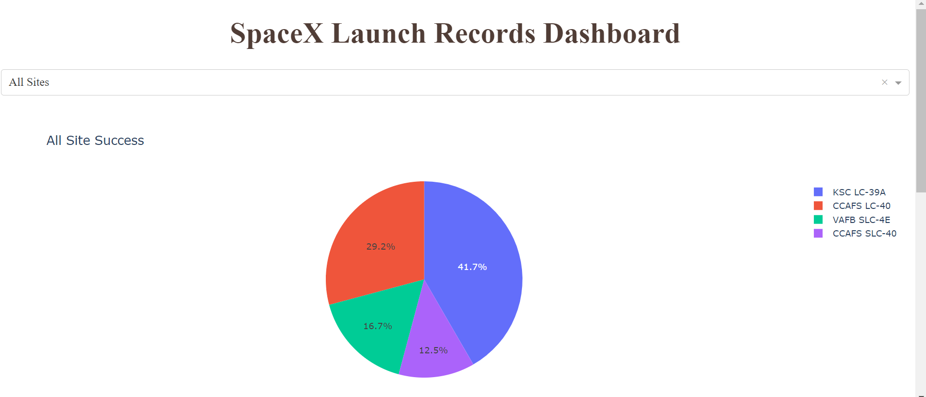
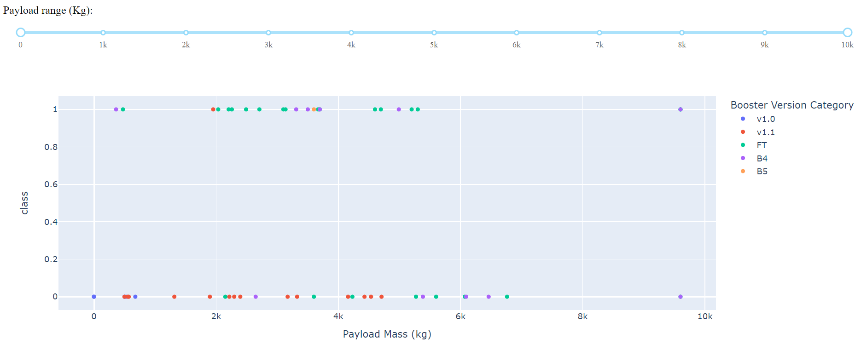
Results
Interactive analytics demo in screenshots
Exploratory data analysis results
Correlations were observed between success rate and payload mass, launch site and Orbit
The strongest corrolation was found between success rate and flight number
The success rate for any configuration of rocket and launch site will improve linearly based on the number of previous launch attempts
Predictive analysis results
LR, SVM and KNN all performed equally well, with a test accuracy of 83.3%,
Decision Trees had an accuracy of 77%, however fit the training data better than the other three models.
The small size of the test data set may have impacted the fitness of the decision tree model, a larger data set and a larger test set might change the results

Slide 18

Section 2

Slide 19
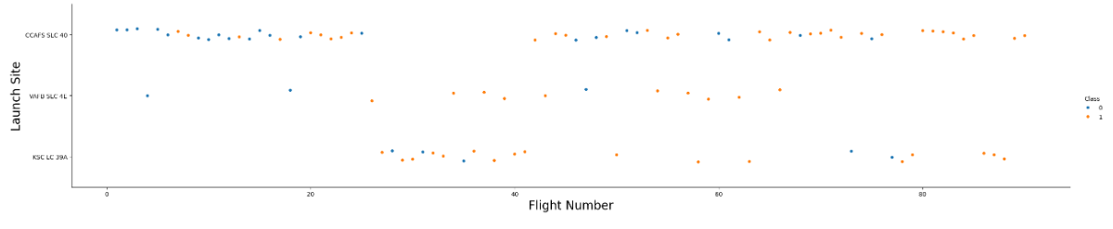
Flight Number vs. Launch Site
It can be observed that CCAFS SLC 40 has the highest rate of failure, but that those failures are mostly early launch numbers
the other two sites had fewer total launches and KSC LC 39A does not show much improvement over time compared to the other two sites

Slide 20
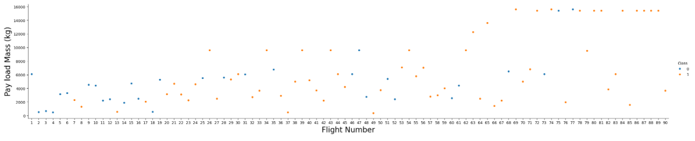
Payload vs. Launch Site
Payload mass increases with launch number, and success rate improves with launch number.
Smaller payloads showed more improvement than larger payloads

Slide 21
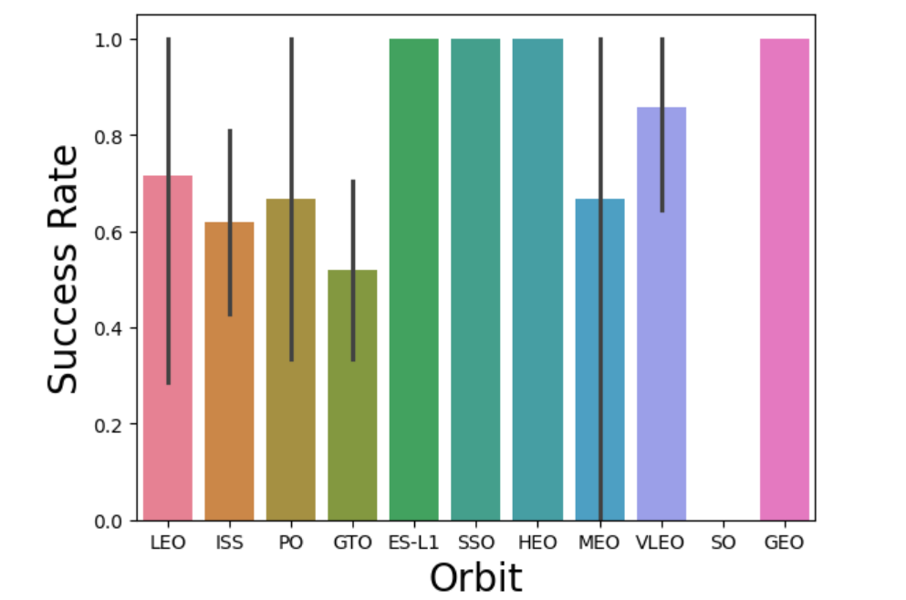
Success Rate vs. Orbit Type
The success rate for some of the orbits is 100%
GTO has the lowest success
GTO and ISS are statistically unlikely to have 100%
success, the remaining orbits vary between 75% and 90%

Slide 22
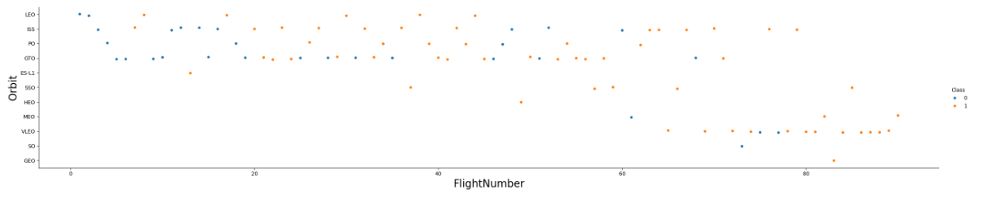
Flight Number vs. Orbit Type
The orbits with the lowest success rate also have the earliest flight numbers
The GEO orbit, which has 100% success, only had 1 flight, similarly SO only had 1 flight and it failed.
Success rate seems to improve for all orbits with more than 1 flight as flight number goes up.

Slide 23
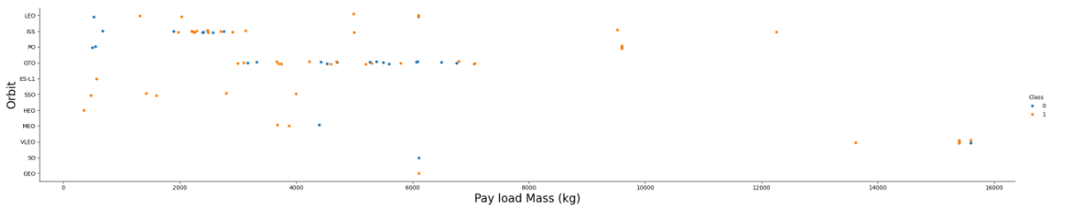
Payload vs. Orbit Type
As payload mass increases success rate for Polar, LEO and ISS

Slide 24
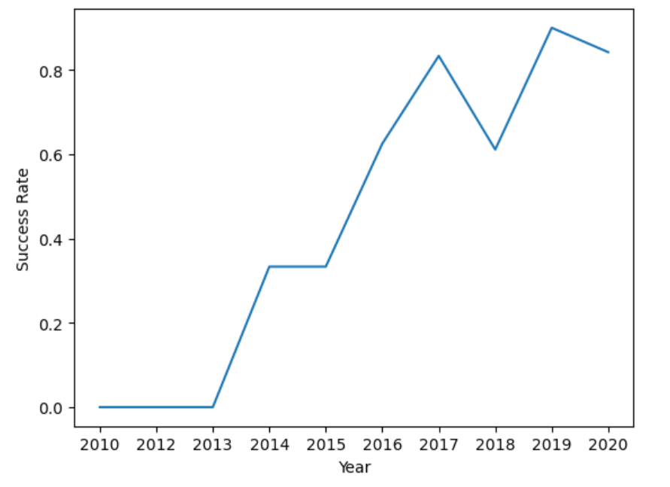
Launch Success Yearly Trend
Success rate increases linearly over time, with the exception of 2018
This trend is the strongest indicator of success in the data set
Equivalent launches will increase in success the more attempts are made

Slide 25
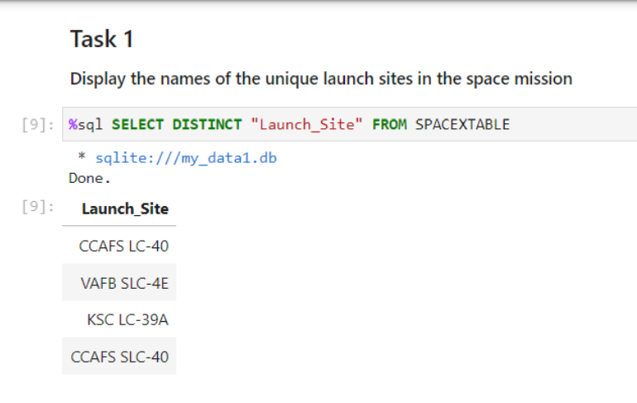
All Launch Site Names
This query shows the unique launch site names

Slide 26
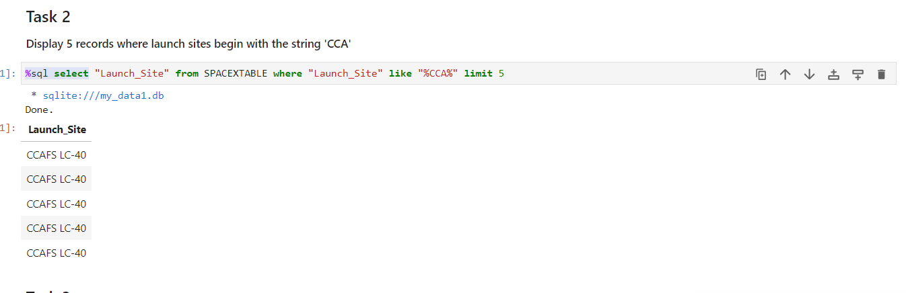
Launch Site Names Begin with 'CCA'
The query looks for the string CCA and limits the records to the first 5

Slide 27
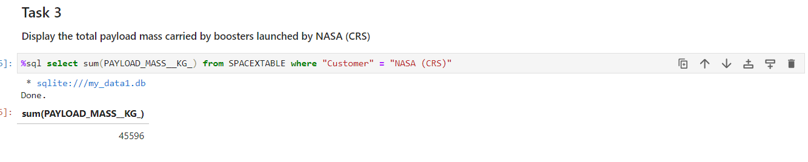
Total Payload Mass
This query calculates the total payload mass carried by boosters launched by NASA (CRS)

Slide 28
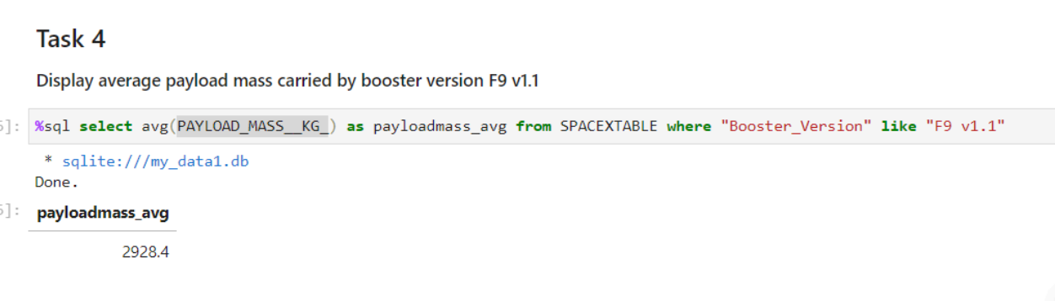
Average Payload Mass by F9 v1.1
This query calculates the average payload for booster F9 v1.1

Slide 29
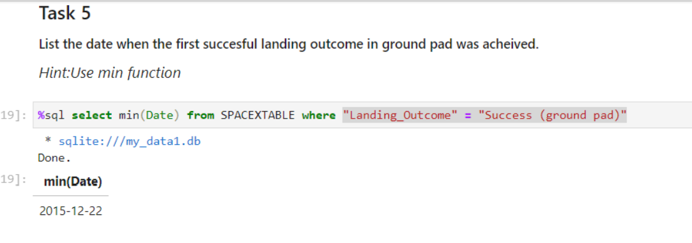
First Successful Ground Landing Date
This query selects the minimum date that meets the landing outcome condition of Success (Ground Pad)

Slide 30
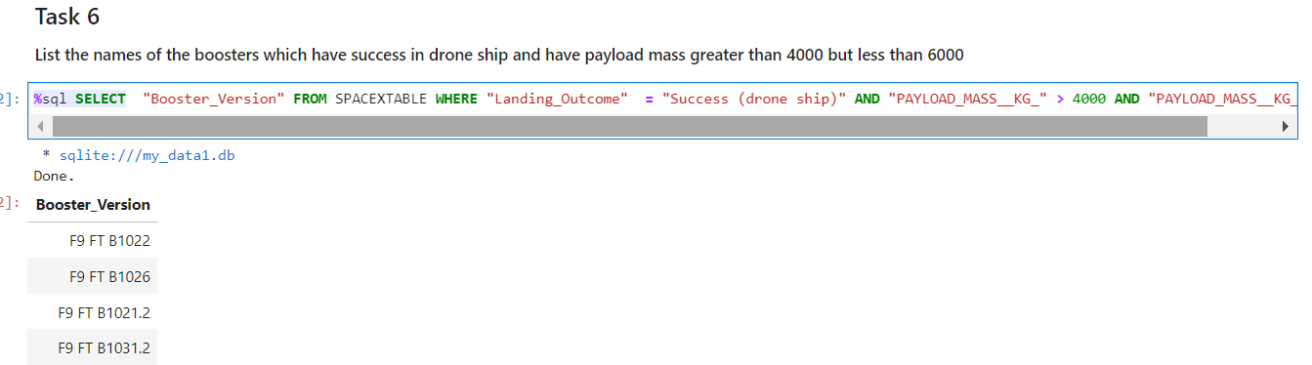
Successful Drone Ship Landing with Payload between 4000 and 6000
This query selects the boosters that had the desired landing outcome and payload range

Slide 31
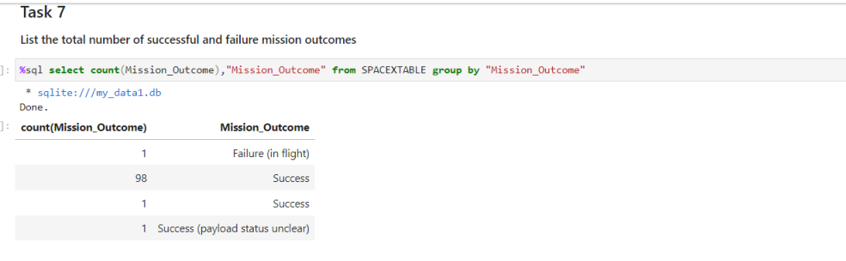
Total Number of Successful and Failure Mission Outcomes
This query shows the different mission outcome totals, 100 successful missions and 1 failure

Slide 32
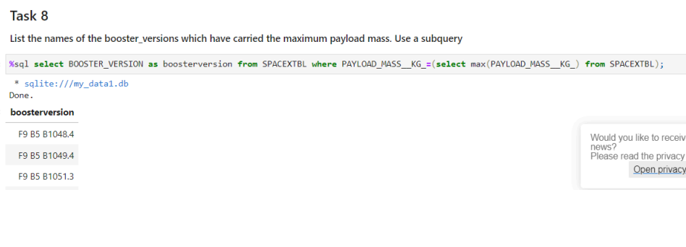
Boosters Carried Maximum Payload
This query filters the booster version to select all the versions that carried the max payload mass

Slide 33
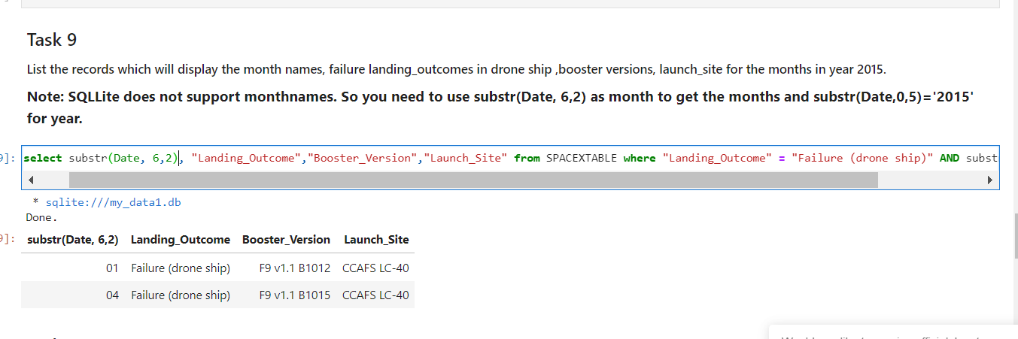
2015 Launch Records
This query lists the drone ship failures in 2015 by month, as well as the launch site and the booster version

Slide 34
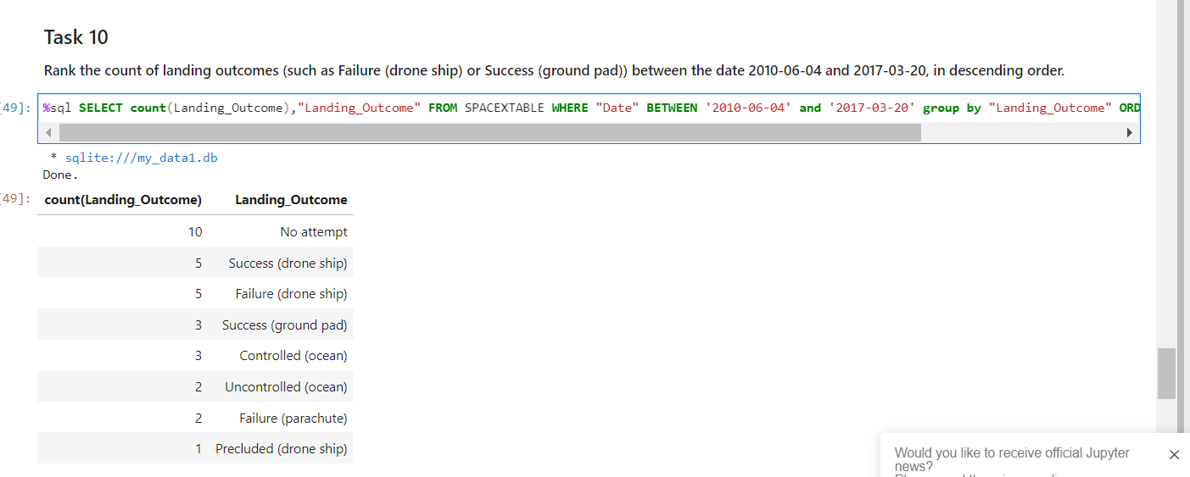
Rank Landing Outcomes Between 2010-06-04 and 2017-03-20
This query ranks the count of landing outcomes between the specified dates in descending order

Slide 35

Section 3

Slide 36
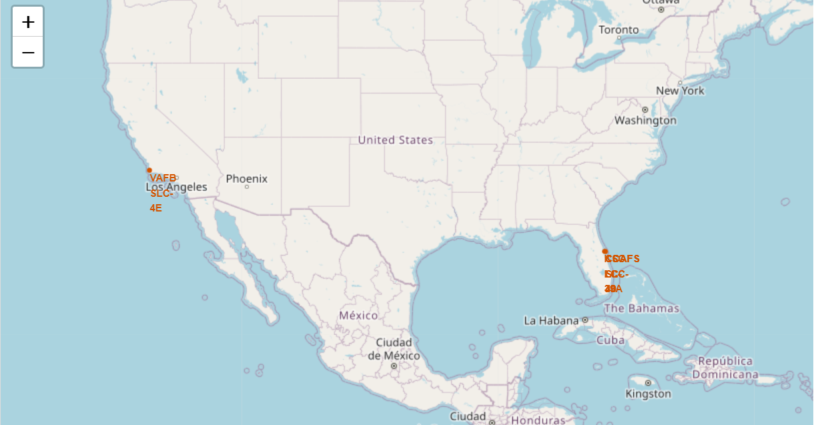
Folium Map Showing all Launch Sites
This map indicates the four launch sites

Slide 37
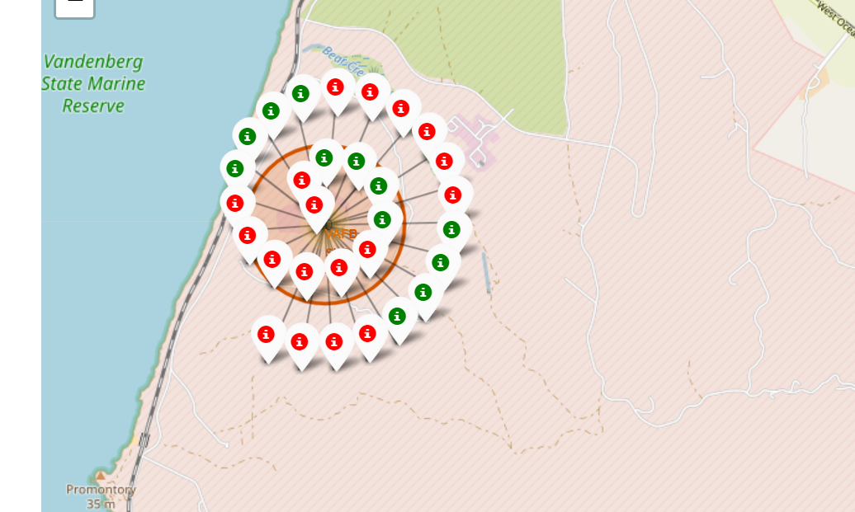
Folium Map of Launch Outcomes at Vandenberg
This map shows the color labelled launch outcomes for Vandenberg.

Slide 38
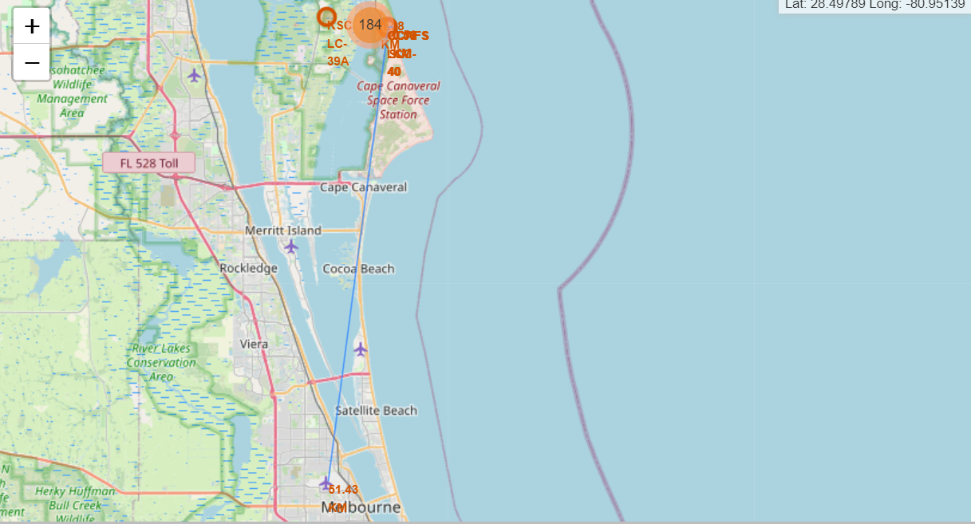
Folium Map 3: Distance lines
This map shows the nearest city, railroad, and road to the CCAFS SLC-40 launch site

Slide 39

Section 4

Slide 40

Pie Chart of All Launch Successes
This figure shows the percent of successful launches out of each site. KSC LC-39A has the most successful launches

Slide 41
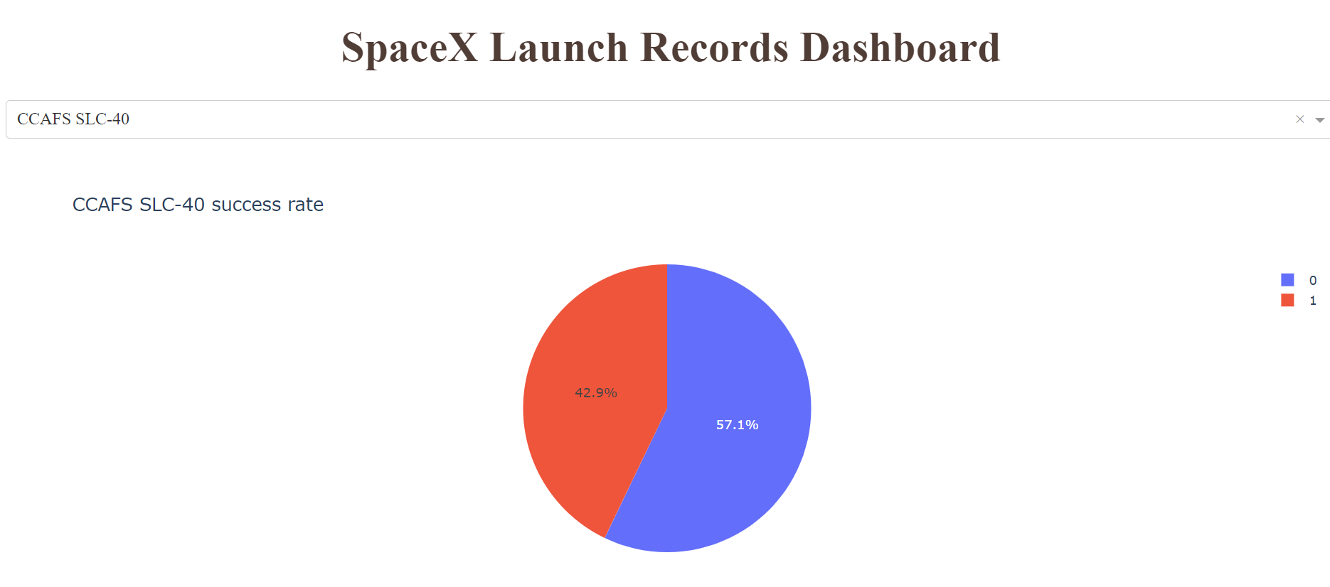
Highest Launch Success Ratio Site
This figure shows the site with the highest success ratio, with 42% of launches being successful

Slide 42
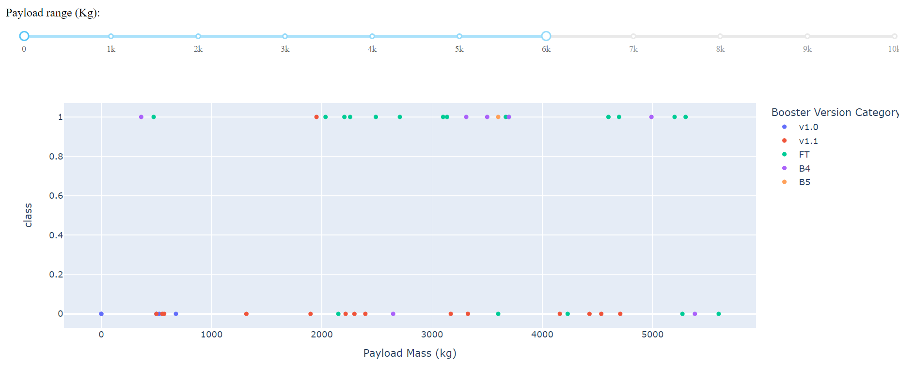
<Dashboard Screenshot 3>
This figure shows the relationship between payload mass, booster version and success rate. Booster V1.1 has a low success rate

Slide 43

Section 5

Slide 44
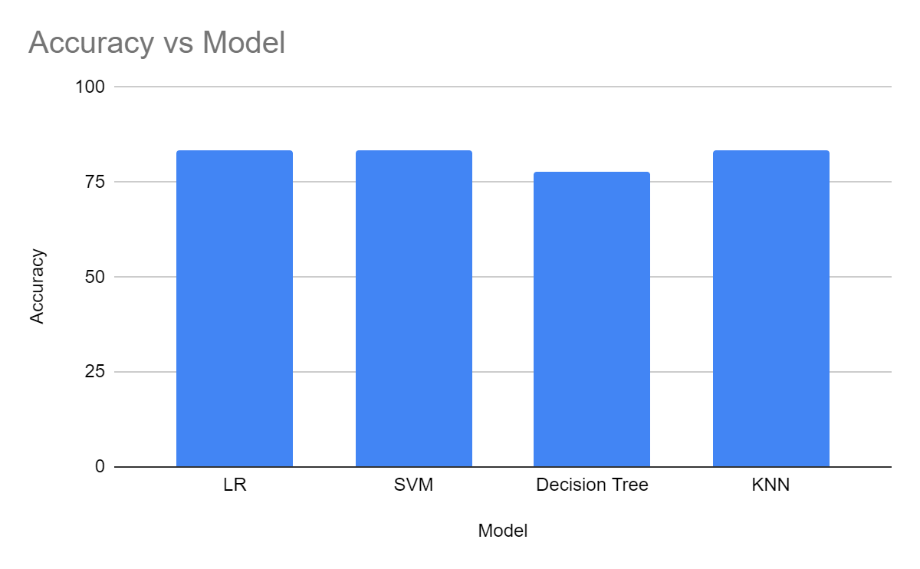
Classification Accuracy
LR, SVM and KNN models all had equally high-test accuracy, at 83.3%
Decision Trees over fit the training data, and tested at 77% accuracy

Slide 45
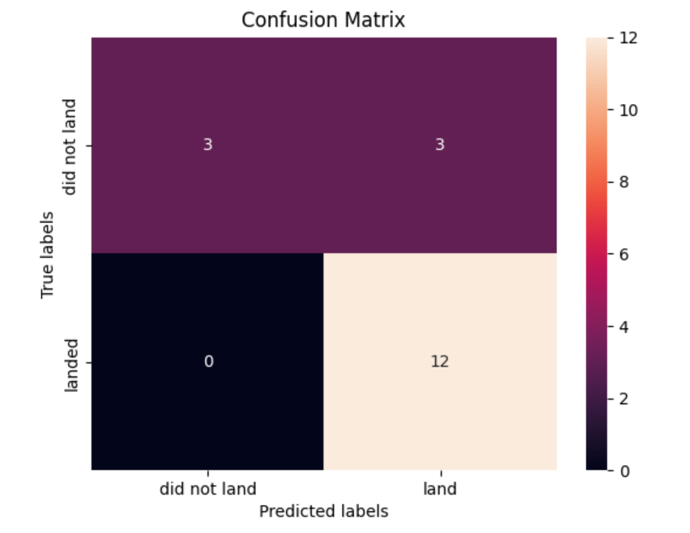
Confusion Matrix
The confusion matrix shows that of the 18 test samples, the model correctly classified 15, and missclassified 3, with 83% accuracy

Slide 46
Conclusions
Launch success increases with practice
Small payloads
For orbits like GEO and SSO, there is insufficient data to predict success rates
As payload mass increases success rates go up for orbits POLAR, LEO, and ISS
All the early flights occurred with low payload mass, at the CCAFS SLC-40 launch site which falsely indicates low payload has lower success rate, and weights the launch site success rate un-realistically
Orbits with few flights are likely to have a lower success rate
While the accuracy of the predictive model is not too bad, I would not bet my company on it yet

Slide 47
Appendix
URL of the github repo with all my project files:
https://github.com/jlonergan35/python_capstone

Slide 48


